Slide 1
第28回全体会合／第3回ハイブリッド会合 All member meeting #28 / Hybrid all member meeting #3
Introducing OpenChain Japan SBOM subgroup activities at All member meeting
July 11, 2023
OpenChain Japan workgroup

Slide 2
All Member Meeting
Date & Time
July 11(Tue), 2023 13:30-17:00 JST
Meeting style:Hybrid
Venue
Physical
Ridgelinez TRANSFORMATION BASE CAMP(X Design Studio)
Online (Online)
Zoom https://zoom.us/j/99975267803?pwd=ekhxaHA3bVZUSVU5M0dVMkF2Z0pkQT09

Slide 3
Agenda
1st Part
13:30 - 13:40 Opening
Keynote (Shane Coughlan/OpenChain)
Welcome Speech (Ito/Ridgelinez)
13:40 - 13:50 OpenChain Japan WG (Kato)
13:50 - 14:20 OSS Community and OpenSSF (Nakamura/Hitachi)
14:20 - 14:50 Education SG (Iwata)
14:50 - 15:20 OSS License Skill Development in Fujitsu (Ouchi/Fujitsu)
(10-minute break)
2nd Part
Breakout Session (Round-table Discussion)
15:30 - 16:00 Discussion Part1
16:00 - 16:30 Discussion Part2
(10-minute break)
3rd Part
16:40 – 17:00 Breakout Session Feedback
17:00 - Closing

Slide 4
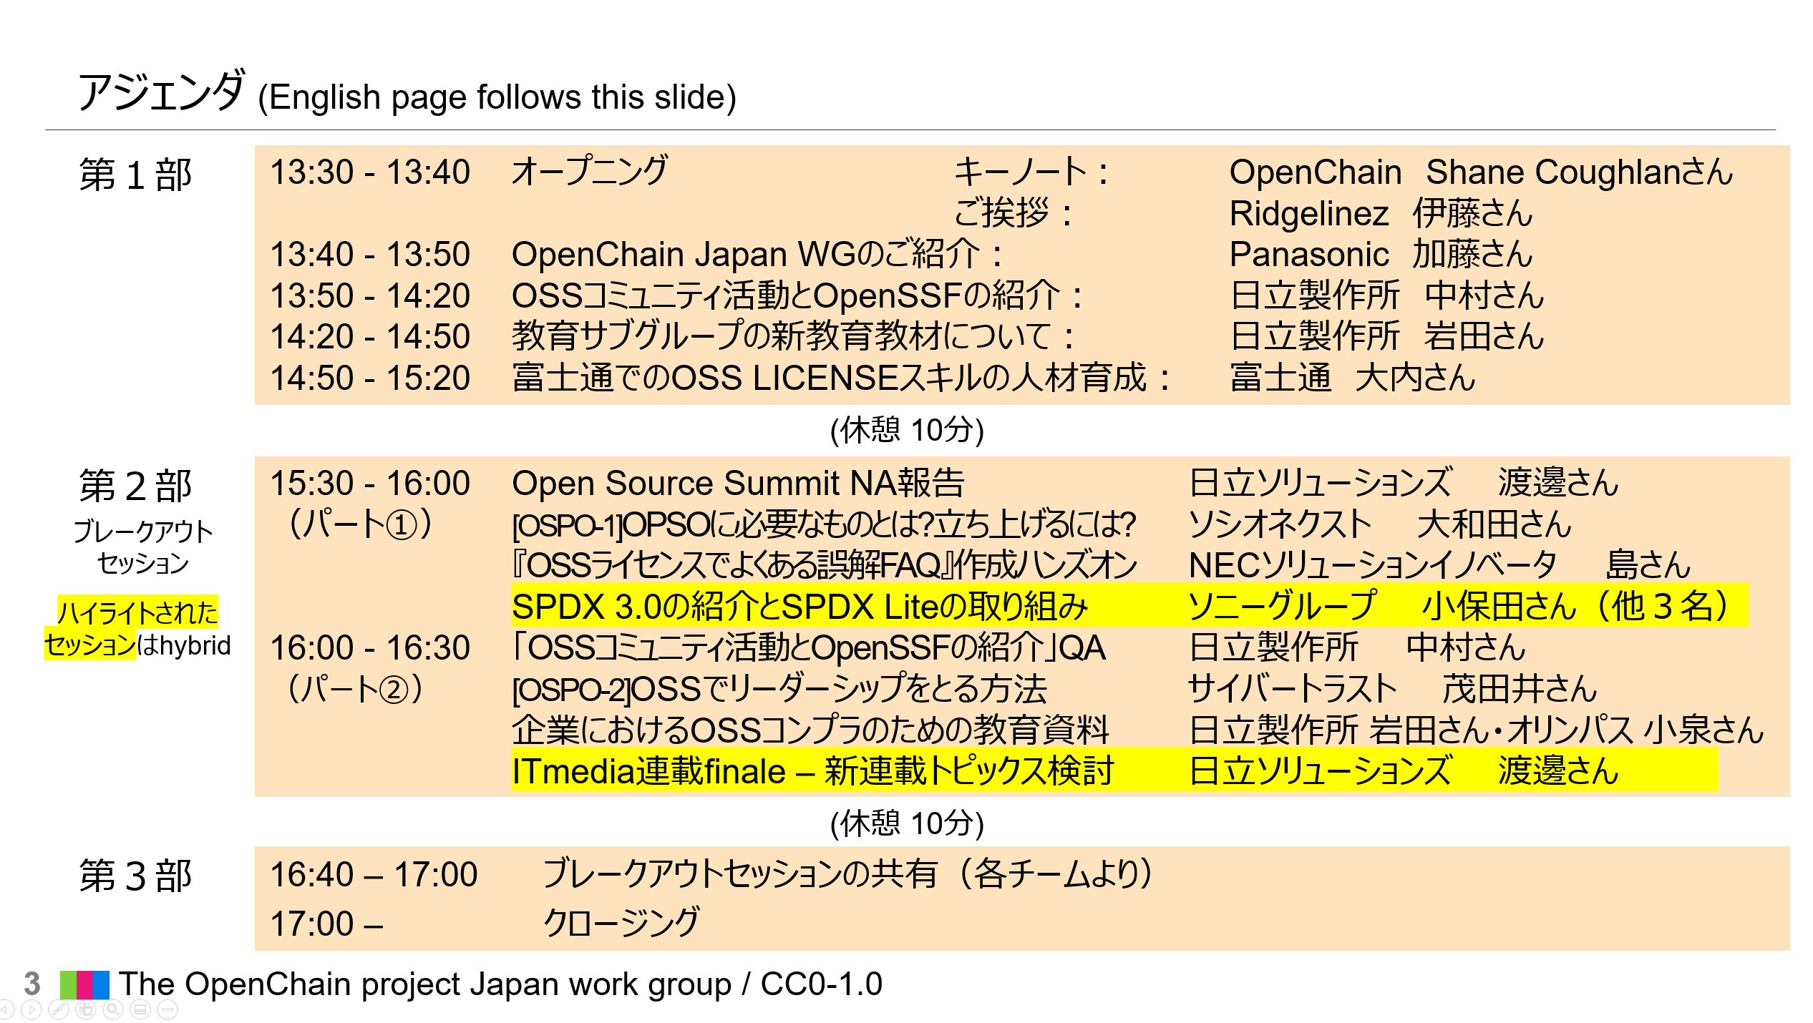
BREAKOUT Sessions
Streaming Sessions

Slide 5
Introducing OpenChain Japan SBOM subgroup
2023/07/11

Slide 6
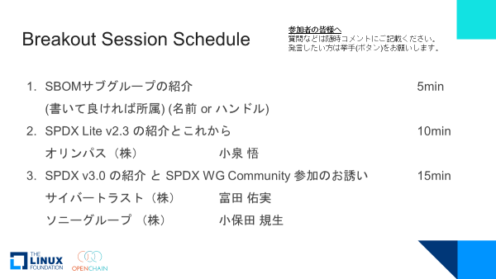
Breakout Session Schedule
Dear Participants,
Please ask your questions in the chat box.
Please raise your hand (button) if you wish to speak out.
Introducing SBOM Subgroups 5min (name or handle) (affiliation if you can write)
Introducing SPDX Lite v2.3 and the next step 10min Olympus Corporation Satoru Koizumi
Introduction to SPDX v3.0 and invitation to join the SPDX WG Community 15min Cybertrust Japan Co., Ltd. Yumi Tomita Sony Group Corporation Norio Koboda

Slide 7
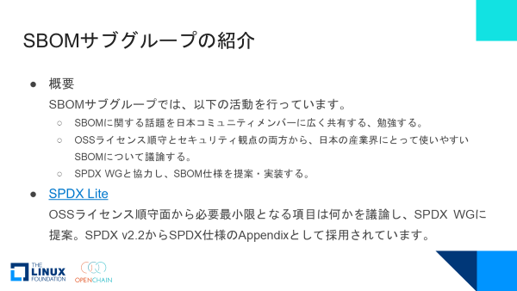
Introducing SBOM Subgroups
Overview The SBOM subgroup performs the following activities:
Share and study topics about SBOMs widely with Japanese community members.
Discuss SBOMs that are easy to use for Japanese industry from both OSS license compliance and security perspectives.
Propose and implement SBOMs specifications in cooperation with the SPDX WG.
SPDX Lite Discuss what are the minimum necessary items from the perspective of OSS license compliance and propose them to the SPDX WG. As a result of our activities, it has been adopted as an Appendix to the SPDX specification since SPDX v2.2.

Slide 8
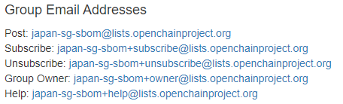
Introducing SBOM Subgroups
👍 Subscribe
To get information about SBOM subgroup, OpenChain JWG
Github OpenChain-JWG/subgroups/sbom-sg at master · OpenChain-Project/OpenChain-JWG · GitHub
Slack
Join OpenChain JWG Slack https://join.slack.com/t/openchain-japanwg/shared_invite/zt-1jf0n0zrb-u77QDi9QAOFnoZzU40hA4A
Join Public Channel #10_sbom-sg https://openchain-japanwg.slack.com/archives/CGDAB378R
ML japan-sg-sbom@lists.openchainproject.org | Home
To join an SBOM subgroup meeting
Announce the meeting schedule on the SBOM sg Channel in ML and Slack. Usually we’ll have a joint meeting every two weeks with Automation sg. A Teams meeting invitation is sent to ML.

Slide 9
Introduction to SPDX Lite v2.2 and future activities
Koizumi-san will explain it in another document!

Slide 10
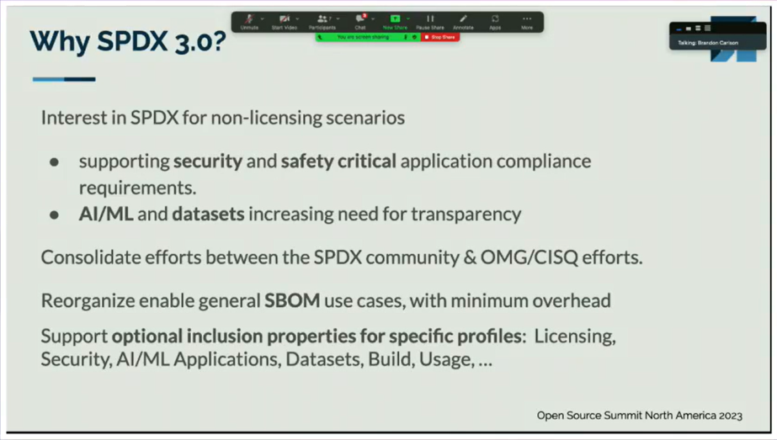
Changes in SPDX 3.0
Difference in Purpose
Up to v2.3
Primarily, OSS License Compliance Perspective
From v3.0
High reliability and security of software
AI/ML and dataset transparency
セキュリティや安全性が重要視されるコンプライアンス要件のサポート
AI/MLとデータセットにおける透明性の必要性の高まり
SPDXコミュニティとOMG/CISQの取り組みの統合
最小限のオーバーヘッドで有効なSBOMユースケースを再編成
特定のプロファイルのための任意で含まれるプロパティをサポート
Open Source Summit North America 2023
SPDX 3.0 Toolng Mini Summit
Video: SPDX 3.0 Overview

Slide 11
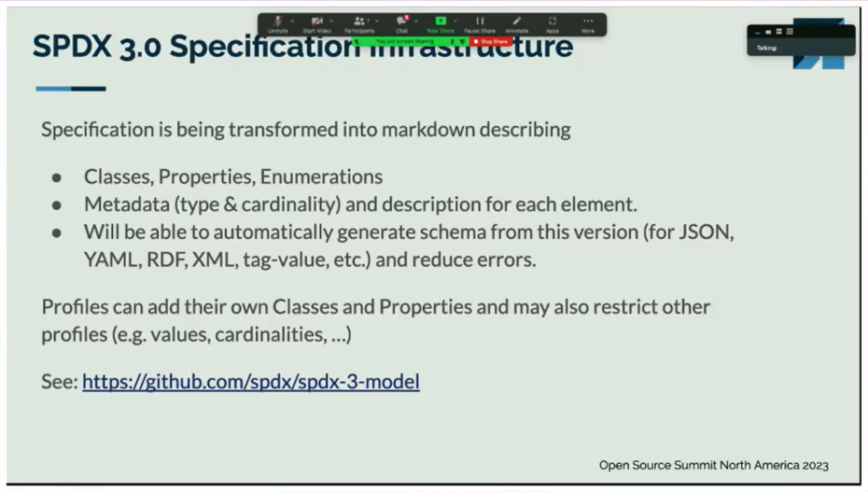
Changes in SPDX 3.0
Structural differences
up to v2.3
Tag-Value combination definition and specification of what should be in Value
From v3.0
Object model defined by classes and properties
Profile is defined and each class, property can be customized
Open Source Summit North America 2023
SPDX 3.0 Toolng Mini Summit
Video: SPDX 3.0 Overview github:https://github.com/spdx/spdx-3-model

Slide 12
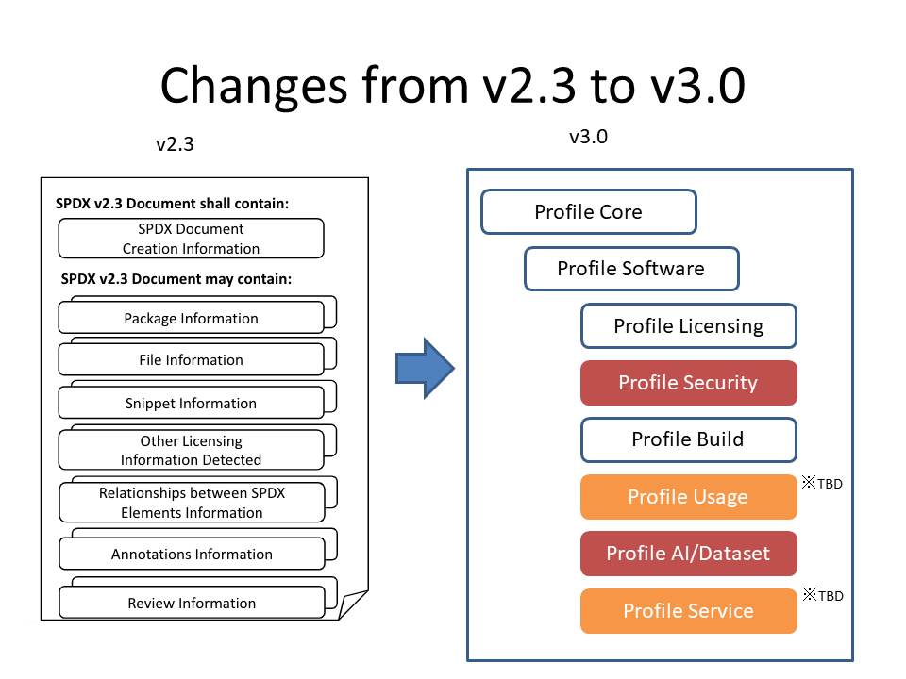
Changes in SPDX 3.0
New Specifications: Profile
Security, AI/Dataset Profile added, package and licensing information separated into Software and Licensing Profiles
Usage, Service Profile under discussion
Lite Profile also proposed by JWG SBOM sg
https://github.com/OpenChain-Project/OpenChain-JWG/blob/master/subgroups/sbom-sg/meetings/20230314/SPDX_version_comparison_en.pptx
Slightly modified

Slide 13
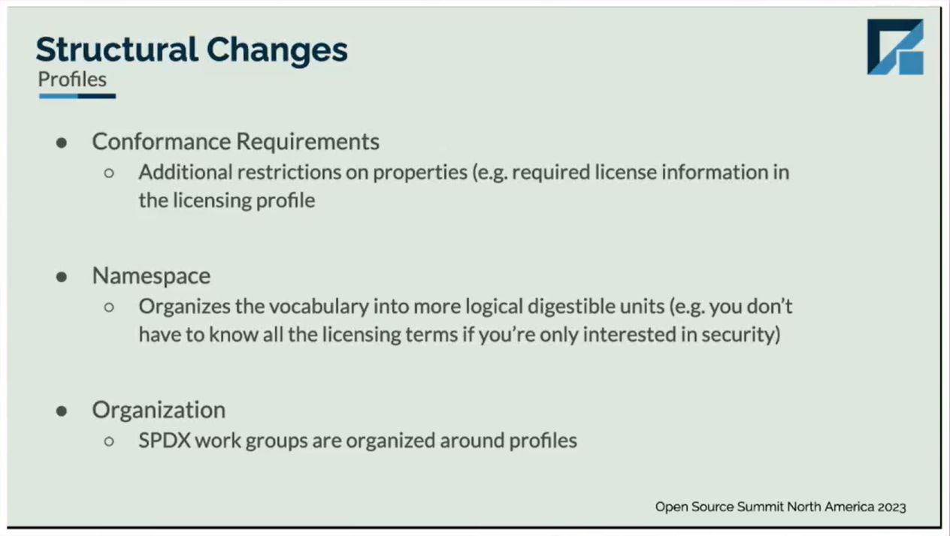
Changes in SPDX 3.0
Profiles
Slightly confusing because it has two meanings
For each profile, constrain how each class uses its properties (Separate required elements by profile, etc.)
Separate namespaces for each profile (Only use information about security, etc.)
適合要件
プロパティへの追加の制約事項
(例：licensing profileにおける必須ライセンス情報)
名前空間
論理的に消化可能な単位に語彙を整理する
(例：セキュリティのみに関心がある場合ライセンスに関するすべての用語を知っている必要はない)
SPDX WGがprofile周りを整理する
Open Source Summit North America 2023
SPDX 3.0 Toolng Mini Summit
Video:2.3 VS 3.0 Comparison Overview

Slide 14
SPDX 3.0 Discussion in SPDX Community
Due to significant changes in specifications from SPDX 2.3, the SPDX WG is conducting online meetings for each subgroup on the following schedule: Some of the meetings are held at night, and although it may be a little difficult to attend from Japan, I think it would be very helpful to participate in topics of your interest.
SPDX meetings (EST/EDT notation, so it's roughly AM00:00- or AM01:00- JST)
https://github.com/spdx/meetings
SPDX- {tech, defects} ML (keep following these two MLs for technical topics)
https://lists.spdx.org/g/spdx-tech
https://lists.spdx.org/g/spdx-defects
SPDX Asia Telco.
9:00 a.m. the second Tuesday of each month - on Zoom
Let us know via ML or Slack if you need it. Get meeting invitations sent.

Slide 15
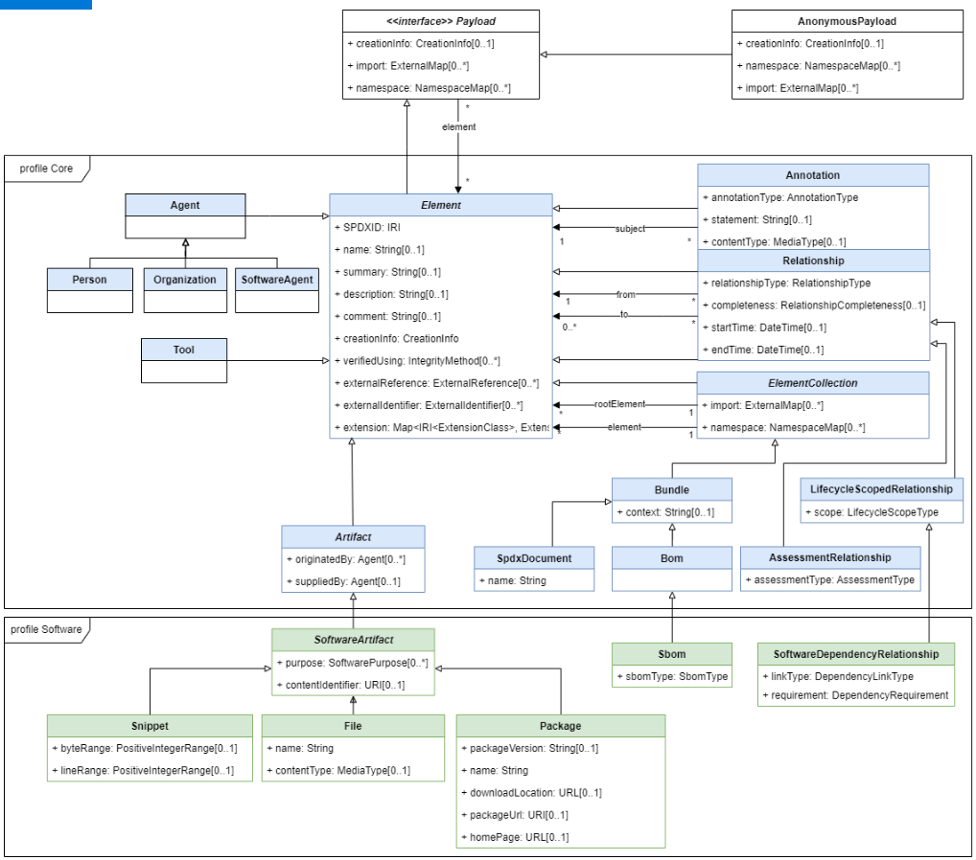
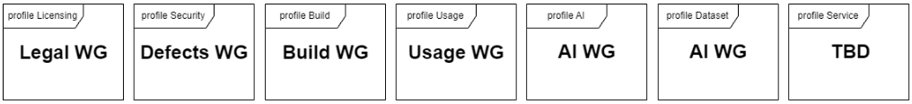
SPDX 3.0 Object Model
It specifies the classes, the properties they have, and their relationships.
Profiles for which classes are not listed, such as Licensing, Security, and so on, are still being discussed in the WG where they are listed.
These class diagrams were created using draw.io, and by using this file, they can be edited in VSCode and so on.
spdx-3-model/model.png at cb37ac018d464cabc11d4b590c7830a489c8f1f5 · spdx/spdx-3-model (github.com)

Slide 16
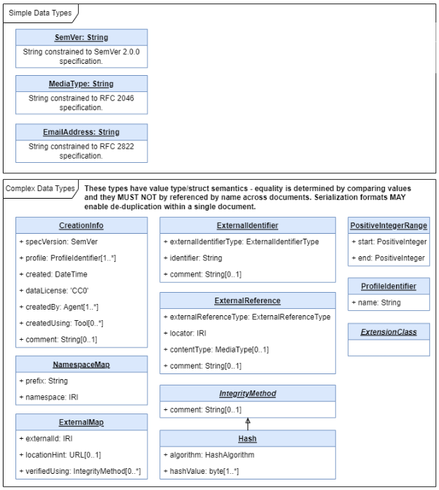
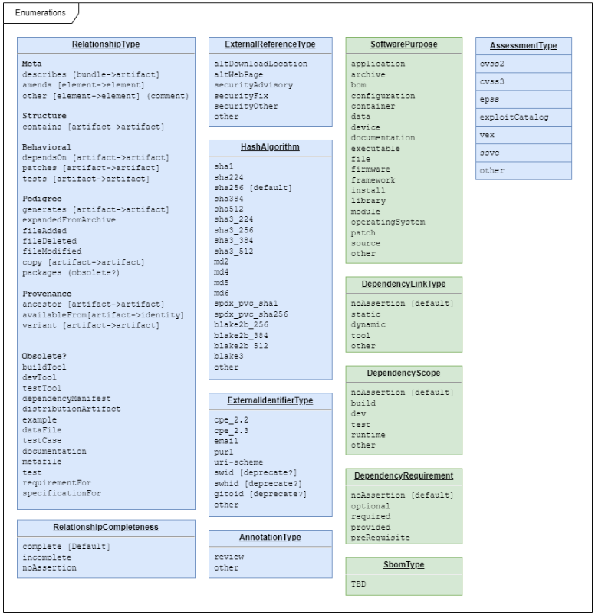
SPDX 3.0 DataTypes
A list of data types for each property and the range of possible data is also specified.

Slide 17
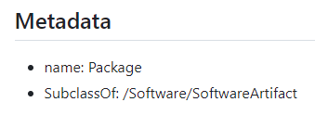
Example: Package Information
Examples
If you want to include information about software packages in the SBOMs
Element
spdx-3-model/model/Core/Classes/Element.md at cb37ac018d464cabc11d4b590c7830a489c8f1f5 · spdx/spdx-3-model · GitHub
Information about software packages should fall under Package Class!
It is a subclass, so you will be referring to higher abstract classes.
inherit
Artifact
spdx-3-model/model/Core/Classes/Artifact.md at cb37ac018d464cabc11d4b590c7830a489c8f1f5 · spdx/spdx-3-model · GitHub
SoftwareArtifact
spdx-3-model/model/Software/Classes/SoftwareArtifact.md at cb37ac018d464cabc11d4b590c7830a489c8f1f5 · spdx/spdx-3-model · GitHub
Package
spdx-3-model/model/Software/Classes/Package.md at cb37ac018d464cabc11d4b590c7830a489c8f1f5 · spdx/spdx-3-model · GitHub
Introducing how to understand the class and data structure.

Slide 18
Properties
Package
SoftwareArtifact
Artifact
Element
The software package information in the SBOM is the set of all properties on the left.
Properties
packageVersion
type: xsd:string
minCount: 0
maxCount: 1
downloadLocation
type: xsd:anyURI
minCount: 0
maxCount: 1
packageUrl
type: xsd:anyURI
minCount: 0
maxCount: 1
homePage
type: xsd:anyURI
minCount: 0
maxCount: 1
sourceInfo
type: xsd:string
minCount: 0
maxCount: 1
Properties
contentIdentifier
type: xsd:anyURI
minCount: 0
maxCount: 1
primaryPurpose
type: SoftwarePurpose
minCount: 0
maxCount: 1
additionalPurpose
type: SoftwarePurpose
minCount: 0
concludedLicense
type: /Licensing/LicenseField
minCount: 0
maxCount: 1
declaredLicense
type: /Licensing/LicenseField
minCount: 0
maxCount: 1
copyrightText
type: xsd:string
minCount: 0
maxCount: 1
attributionText
type: xsd:string
minCount: 0
maxCount: 1
Properties
originatedBy
type: Agent
minCount: 0
suppliedBy
type: Agent
minCount: 0
builtTime
type: DateTime
minCount: 0
maxCount: 1
releaseTime
type: DateTime
minCount: 0
maxCount: 1
validUntilTime
type: DateTime
minCount: 0
maxCount: 1
standard
type: xsd:string
minCount: 0
Properties
spdxId
type: xsd:anyURI
minCount: 1
maxCount: 1
name
type: xsd:string
maxCount: 1
summary
type: xsd:string
maxCount: 1
description
type: xsd:string
maxCount: 1
comment
type: xsd:string
maxCount: 1
creationInfo
type: CreationInfo
minCount: 0
maxCount: 1
verifiedUsing
type: IntegrityMethod
externalReference
type: ExternalReference
minCount: 0
externalIdentifier
type: ExternalIdentifier
minCount: 0
extension
type: Extension
minCount: 0

Slide 19
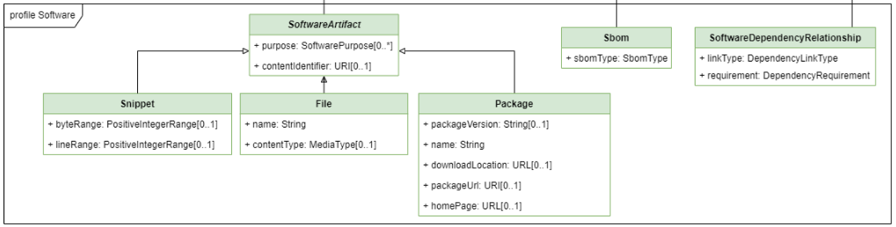
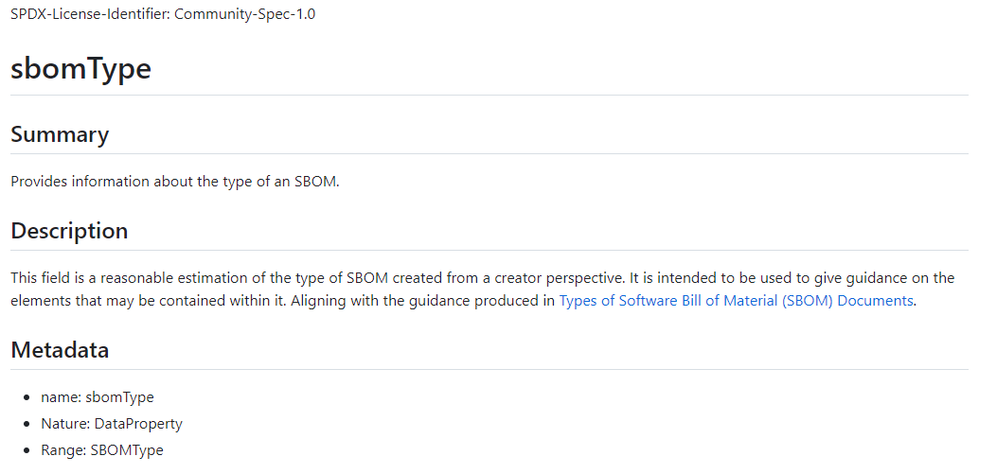
Details for each property
SBOM
spdx-3-model/model/Software/Classes/Sbom.md at cb37ac018d464cabc11d4b590c7830a489c8f1f5 · spdx/spdx-3-model · GitHub
Properties
sbomType
type: SBOMType
minCount: 0
Details for the properties exist as markdown files under model/[each profile]/Properties. For example, a property called sbomType in the SBOM class of the Software Profile is described in/model/Software/Properties/sbomType.md.
spdx-3-model/model/Software/Properties/sbomType.md at cb37ac018d464cabc11d4b590c7830a489c8f1f5 · spdx/spdx-3-model · GitHub
Introducing which file has a detailed description of the property

Slide 20
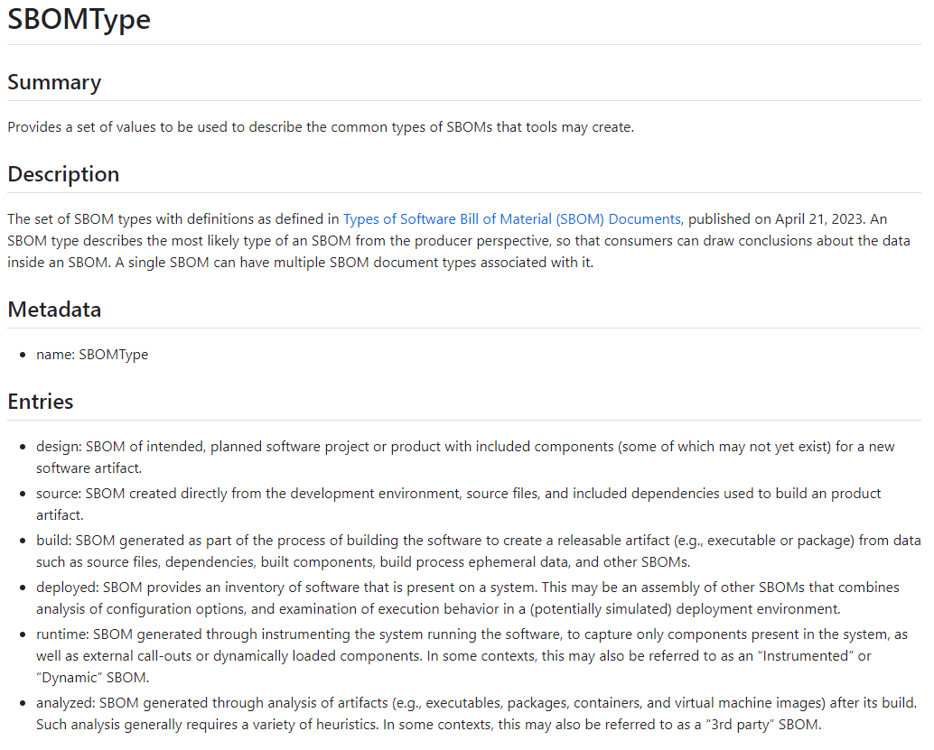
Range of values to set for each property
The property is Key - Value, but Vocabularies are set if you want to limit the range that can be set for that Value side. A description of the range of possible values can be found in the markdown file under model/[each profile]/Vocabularies.
spdx-3-model/model/Software/Vocabularies/SBOMType.md at cb37ac018d464cabc11d4b590c7830a489c8f1f5 · spdx/spdx-3-model · GitHub

Slide 21
Thank you!

Slide 22
2. SPDX Lite
Prerequisite We interpret “profile” to allow us to put restrictions on properties.
Our Intension We agree that the more items in an SBOM, the more useful it is for complex software supply chains. On the other hands, we want to make it as simple as possible in our software distribution use cases. Therefore, we want to define as a profile a collection of minimum elements that meet the following requirements:
Use for open source license clearance
NTIA minimum elements for a SBOM compliant

Slide 23
Example
The following properties are defined for SBOMs that represent Packages:
Package
SoftwareArtifact
Artifact
Element
Properties
packageVersion
type: xsd:string
minCount: 0
maxCount: 1
downloadLocation
type: xsd:anyURI
minCount: 0
maxCount: 1
packageUrl
type: xsd:anyURI
minCount: 0
maxCount: 1
homePage
type: xsd:anyURI
minCount: 0
maxCount: 1
sourceInfo
type: xsd:string
minCount: 0
maxCount: 1
Properties
contentIdentifier
type: xsd:anyURI
minCount: 0
maxCount: 1
primaryPurpose
type: SoftwarePurpose
minCount: 0
maxCount: 1
additionalPurpose
type: SoftwarePurpose
minCount: 0
concludedLicense
type: /Licensing/LicenseField
minCount: 0
maxCount: 1
declaredLicense
type: /Licensing/LicenseField
minCount: 0
maxCount: 1
copyrightText
type: xsd:string
minCount: 0
maxCount: 1
attributionText
type: xsd:string
minCount: 0
maxCount: 1
Properties
originatedBy
type: Agent
minCount: 0
suppliedBy
type: Agent
minCount: 0
builtTime
type: DateTime
minCount: 0
maxCount: 1
releaseTime
type: DateTime
minCount: 0
maxCount: 1
validUntilTime
type: DateTime
minCount: 0
maxCount: 1
standard
type: xsd:string
minCount: 0
Properties
spdxId
type: xsd:anyURI
minCount: 1
maxCount: 1
name
type: xsd:string
maxCount: 1
summary
type: xsd:string
maxCount: 1
description
type: xsd:string
maxCount: 1
comment
type: xsd:string
maxCount: 1
creationInfo
type: CreationInfo
minCount: 0
maxCount: 1
verifiedUsing
type: IntegrityMethod
externalReference
type: ExternalReference
minCount: 0
externalIdentifier
type: ExternalIdentifier
minCount: 0
extension
type: Extension
minCount: 0

Slide 24
Example
The following properties are defined for SBOMs that represent Packages:
Package
SoftwareArtifact
Artifact
Element
Properties
packageVersion
type: xsd:string
minCount: 0
maxCount: 1
downloadLocation
type: xsd:anyURI
minCount: 0
maxCount: 1
packageUrl
type: xsd:anyURI
minCount: 0
maxCount: 1
homePage
type: xsd:anyURI
minCount: 0
maxCount: 1
sourceInfo
type: xsd:string
minCount: 0
maxCount: 1
Properties
contentIdentifier
type: xsd:anyURI
minCount: 0
maxCount: 1
primaryPurpose
type: SoftwarePurpose
minCount: 0
maxCount: 1
additionalPurpose
type: SoftwarePurpose
minCount: 0
concludedLicense
type: /Licensing/LicenseField
minCount: 0
maxCount: 1
declaredLicense
type: /Licensing/LicenseField
minCount: 0
maxCount: 1
copyrightText
type: xsd:string
minCount: 0
maxCount: 1
attributionText
type: xsd:string
minCount: 0
maxCount: 1
Properties
originatedBy
type: Agent
minCount: 0
suppliedBy
type: Agent
minCount: 0
builtTime
type: DateTime
minCount: 0
maxCount: 1
releaseTime
type: DateTime
minCount: 0
maxCount: 1
validUntilTime
type: DateTime
minCount: 0
maxCount: 1
standard
type: xsd:string
minCount: 0
Properties
spdxId
type: xsd:anyURI
minCount: 1
maxCount: 1
name
type: xsd:string
maxCount: 1
summary
type: xsd:string
maxCount: 1
description
type: xsd:string
maxCount: 1
comment
type: xsd:string
maxCount: 1
creationInfo
type: CreationInfo
minCount: 0
maxCount: 1
verifiedUsing
type: IntegrityMethod
externalReference
type: ExternalReference
minCount: 0
externalIdentifier
type: ExternalIdentifier
minCount: 0
extension
type: Extension
minCount: 0
May be indicating mandatory

Slide 25
Example
We’d like to propose a profile in which the minimum required elements are defined as mandatory.
Based on SPDX Lite v2.3.
Lite Profile
Package
SoftwareArtifact
Artifact
Element
minCount: 1
maxCount: 1..n
Properties
packageVersion
type: xsd:string
minCount: 0
maxCount: 1
downloadLocation
type: xsd:anyURI
minCount: 0
maxCount: 1
packageUrl
type: xsd:anyURI
minCount: 0
maxCount: 1
homePage
type: xsd:anyURI
minCount: 0
maxCount: 1
sourceInfo
type: xsd:string
minCount: 0
maxCount: 1
Properties
contentIdentifier
type: xsd:anyURI
minCount: 0
maxCount: 1
primaryPurpose
type: SoftwarePurpose
minCount: 0
maxCount: 1
additionalPurpose
type: SoftwarePurpose
minCount: 0
concludedLicense
type: /Licensing/LicenseField
minCount: 0
maxCount: 1
declaredLicense
type: /Licensing/LicenseField
minCount: 0
maxCount: 1
copyrightText
type: xsd:string
minCount: 0
maxCount: 1
attributionText
type: xsd:string
minCount: 0
maxCount: 1
Properties
originatedBy
type: Agent
minCount: 0
suppliedBy
type: Agent
minCount: 0
builtTime
type: DateTime
minCount: 0
maxCount: 1
releaseTime
type: DateTime
minCount: 0
maxCount: 1
validUntilTime
type: DateTime
minCount: 0
maxCount: 1
standard
type: xsd:string
minCount: 0
Properties
spdxId
type: xsd:anyURI
minCount: 1
maxCount: 1
name
type: xsd:string
maxCount: 1
summary
type: xsd:string
maxCount: 1
description
type: xsd:string
maxCount: 1
comment
type: xsd:string
maxCount: 1
creationInfo
type: CreationInfo
minCount: 0
maxCount: 1
verifiedUsing
type: IntegrityMethod
externalReference
type: ExternalReference
minCount: 0
externalIdentifier
type: ExternalIdentifier
minCount: 0
extension
type: Extension
minCount: 0

Slide 26
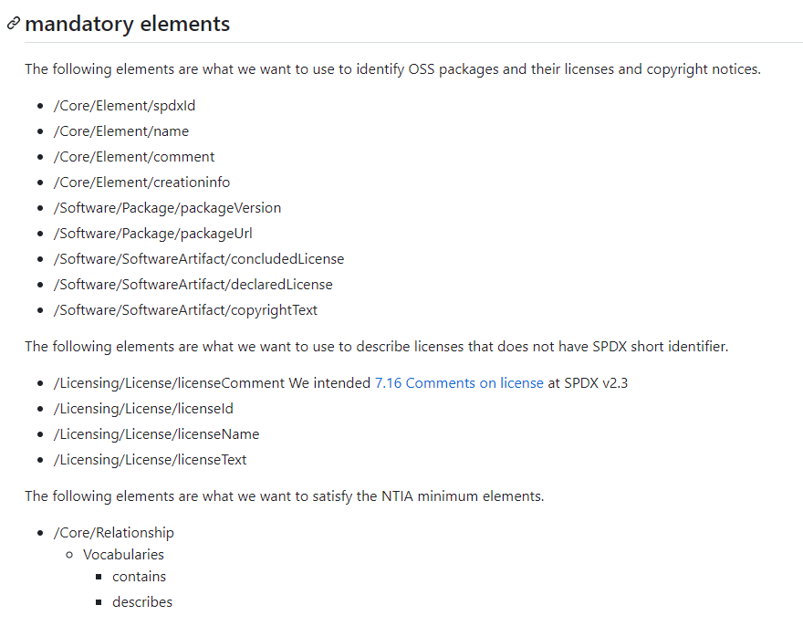
What elements we consider mandatory
OpenChain-JWG/subgroups/sbom-sg/outcomes/SPDX-Lite/Proposal_v3.0/model/Comment-for-Issue384-20230616.md at master · OpenChain-Project/OpenChain-JWG · GitHub

Slide 27
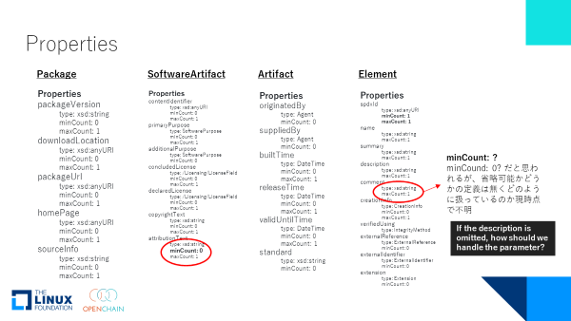
3. How we collaborate and propose specifications with the SPDX WG
Studying SPDX Specification by participating MLs and meetings. (each individuals)
Sharing our understandings in the Japanese Community.
Discussing the ideal SBOM specification from our use cases and requirements.
Asking the SPDX community about specifications that are difficult to understand.
https://github.com/OpenChain-Project/OpenChain-JWG/tree/master/subgroups/sbom-sg/meetings

Slide 28
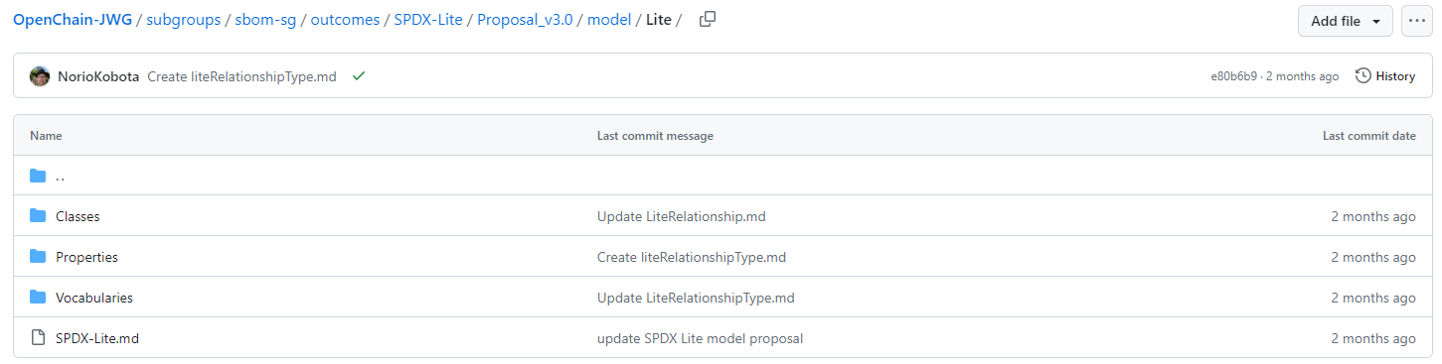
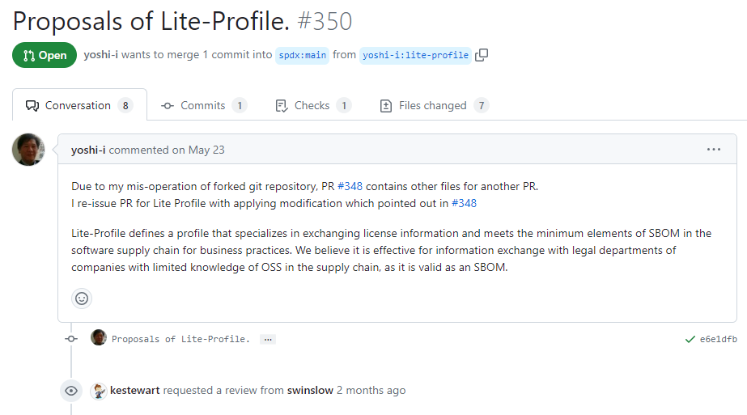
How we collaborate and propose specifications with the SPDX WG
Creating the draft specification on our github.
Sending PRs or creating issues on SPDX github.
OpenChain-JWG/subgroups/sbom-sg/outcomes/SPDX-Lite/Proposal_v3.0/model/Lite at master · OpenChain-Project/OpenChain-JWG · GitHub
Proposals of Lite-Profile. by yoshi-i · Pull Request #350 · spdx/spdx-3-model (github.com)

Slide 29
Pros. and Cons. Of this activities
Pros.
If there is a knowledgeable person who is doing research on SBOMs in Japanese:
Many people can become familiar with SBOMs easily. There are still difficulties in learning using English materials..
Information can be exchanged with SBOM Usecase about software supply chain in Japanese companies and industries.
We can exchange detailed opinions in Japanese about the difficulty of specifications.
Cons.
If the person who mainly works is busy, the response to the SPDX community tends to be delayed...
Tough to follow up on SPDX community discussions.
We appreciate the continued support of the SPDX community!
Thanks!

